Slide 1
Structure Programming
ICT-1105
Information and Communication Technology
Lecture-05_06
Date:

Slide 2
Class contents has given in Google Classroom with code
nhauiw4
Notes:
AT&T – American Telephone & Telegraph Company

Slide 3
First C Program
1. #include <stdio.h>
2. #include <conio.h>
3. void main(){
4. printf("Hello C Language");
5. getch();
6. }
Notes:
AT&T – American Telephone & Telegraph Company

Slide 4
First C Program
#include <stdio.h> includes the standard input output library functions. The printf() function is defined in stdio.h .
#include <conio.h> includes the console input output library functions. The getch() function is defined in conio.h file.
Notes:
AT&T – American Telephone & Telegraph Company

Slide 5
First C Program
void main() The main() function is the entry point of every program in c language. The void keyword specifies that it returns no value.
printf() The printf() function is used to print data on the console.
getch() The getch() function asks for a single character. Until you press any key, it blocks the screen.
Notes:
AT&T – American Telephone & Telegraph Company

Slide 6
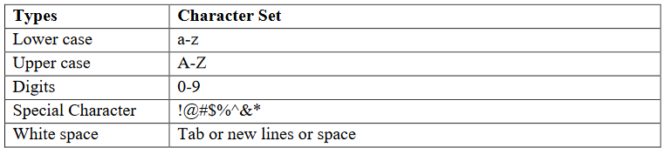
Character Set
Communicating with a computer involves speaking the language the computer understands. In C, various characters have been given to communicate.
Character set in C consists of;
Notes:
AT&T – American Telephone & Telegraph Company

Slide 7
C TOKENS
The smallest individual units are known as tokens. C has six types of tokens.
1: Identifiers
2: Keywords
3: Constants
4: Strings
5: Special Symbols
6: Operators

Slide 8
Identifiers
Identifiers refer to the names of variables, constants, functions and arrays. These user-defined names is called Identifiers. These identifier are defined against a set of rules.

Slide 9
Rules for an Identifier
1. An Identifier can only have alphanumeric characters( a-z , A-Z , 0-9 ) and underscore( _).
2. The first character of an identifier can only contain alphabet( a-z , A-Z ) or underscore ( _ ).
3. Identifiers are also case sensitive in C. For example name and Name are two different identifier in C

Slide 10
Rules for an Identifier
4. Keywords are not allowed to be used as Identifiers.
5. No special characters, such as semicolon, period, whitespaces, slash or comma are permitted to be used in or as Identifier.
6. C’ compiler recognizes only the first 31 characters of an identifiers.

Slide 11
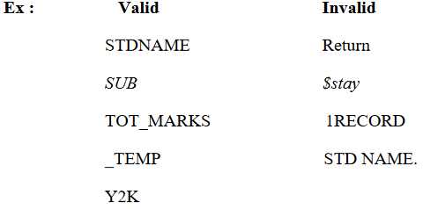
Rules for an Identifier

Slide 12
Keywords
A keyword is a reserved word.
All keywords have fixed meaning that means we cannot change.
All keywords must be written in lowercase.
Keywords serve as basic building blocks for program statements.
The keywords cannot be used as variable names because if we do so we are trying to assign a new meaning to the keyword, which is not allowed by the computer.
C language has 32 keywords

Slide 13
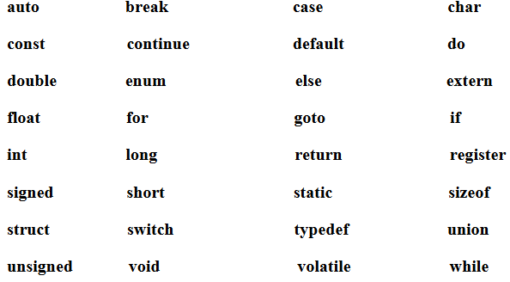
Keywords

Slide 14
Data Types
To store data the program must reserve space which is done using datatype. A datatype is a keyword/predefined instruction used for allocating memory for data. A data type specifies the type of data that a variable can store such as integer, floating, character etc. It used for declaring/defining variables or functions of different types before to use in a program.

Slide 15
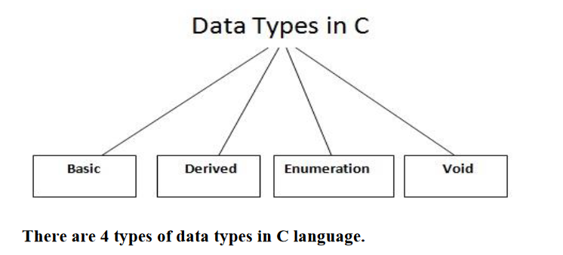
Data Types

Slide 16
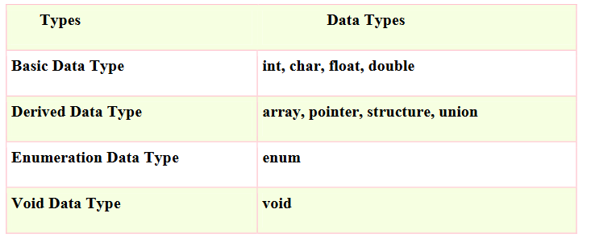
Data Types

Slide 17
Data Types
There are 4 fundamental data types in C, which are- char, int, float &, double. Char is used to store any single character; int is used to store any integer value, float is used to store any single precision floating point number & double is used to store any double precision floating point number. We can use 2 qualifiers with these basic types to get more types.
There are 2 types of qualifiers-
  Sign qualifier- signed & unsigned
  Size qualifier- short & long

Slide 18
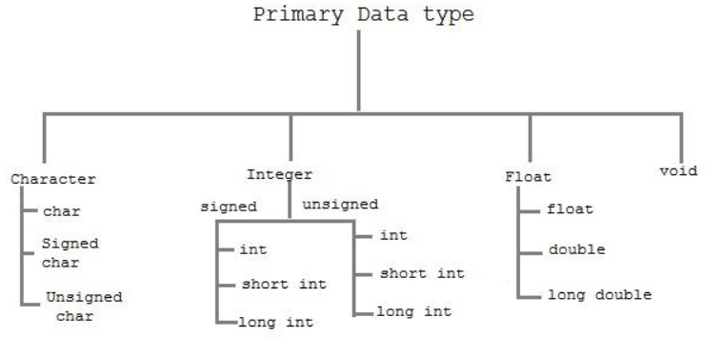
Data Types

Slide 19
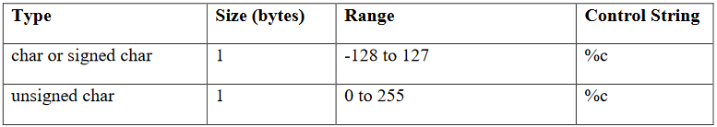
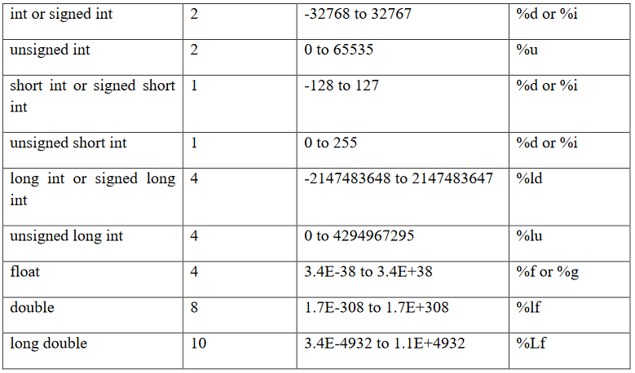

Slide 20
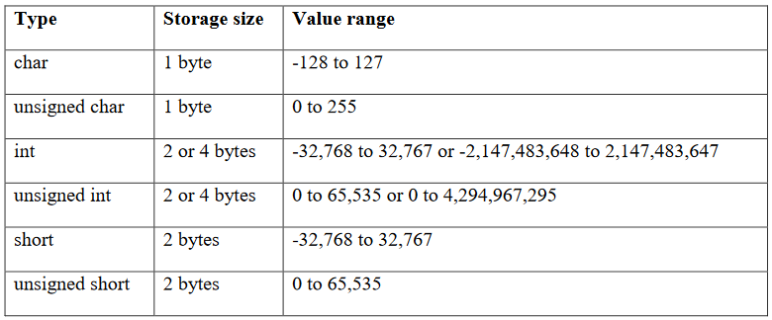

Data Types
The data types in C can be classified as follows:

Slide 21
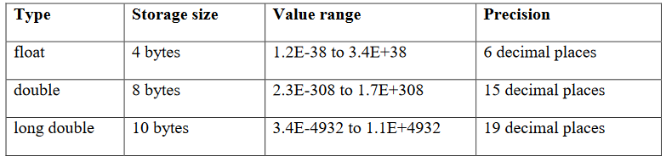
Data Types
The data types in C can be classified as follows:

Slide 22
Constant
Constants refer to fixed values that do not change during the execution of a program.
constants are also called literals.
C supports several kinds of constants.

Slide 23
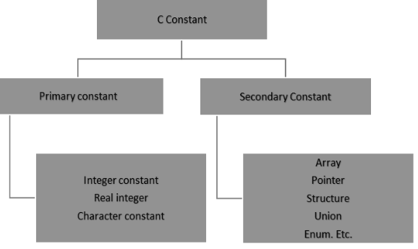
Constant
C constants can be divided into two major categories:
Primary Constants
Secondary Constants

Slide 24
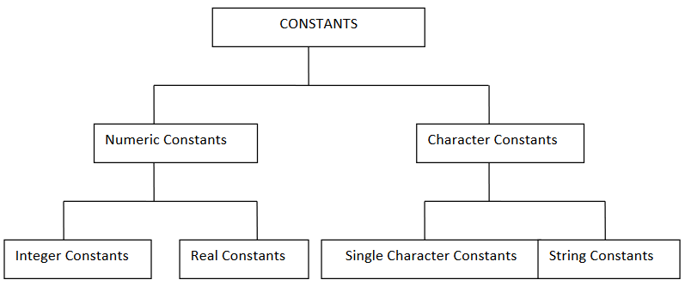
Constant

Slide 25
Constant
TYPES OF C CONSTANT:
1. Integer constants
2. Real or Floating point constants
3. Character constants
4. String constants
5. Backslash character constants

Slide 26
Integer constants
An integer constant is a numeric constant (associated with number) without any fractional or exponential part. There are three types of integer constants in C programming:
decimal constant(base 10)
octal constant(base 8)
hexadecimal constant(base 16)

Slide 27
Integer constants
For example:
Decimal constants: 0, -9, 22 etc
Octal constants: 021, 077, 033 etc
Hexadecimal constants: 0x7f, 0x2a, 0x521 etc
In C programming, octal constant starts with a 0 and hexadecimal constant starts with a 0x.

Slide 28
Integer constants
1: Decimal Integer : the rules for represent decimal integer.
a) Decimal Integer value which consist of digits from 0-9.
b) Decimal Integer value with base 10.
c) Decimal Integer should not prefix with 0.
d) It allows only sign (+,-).
e) No special character allowed in this integer.

Slide 29
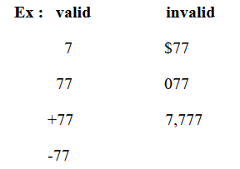
Integer constants

Slide 30
Integer constants
2 : Octal : An integer constants with base 8 is called octal. These rules are :
a) it consist of digits from 0 to 7.
b) It should prefix with 0.
c) It allows sign (+,-).
d) No special character is allowed.

Slide 31
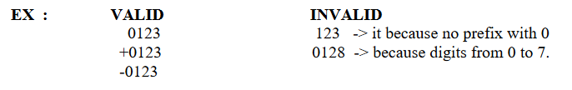
Integer constants

Slide 32
Integer constants
3 : Hexadecimal : An integer constant with base value 16 is called Hexadecimal.
a) It consist of digits from 0-9,a-f(capital letters & small leters.
Ex : 0 1 2 3 4 5 6 7 8 9 a b c d e f
b) it should prefix with 0X or 0x.
c) it allows sign (+,-).
d) No special character is allowed.
EX : OX1a, ox2f

Slide 33
Integer constants
Rules for Constructing Integer Constants:
An integer constant must have at least one digit.
a) It must not have a decimal point.
b) It can be either positive or negative.
c) If no sign precedes an integer constant it is assumed to be positive.
d) No commas or blanks are allowed within an integer constant.
e) The allowable range for integer constants is -32768 to 32767.
Ex.: 426, +782,-8000, -7605

Slide 34
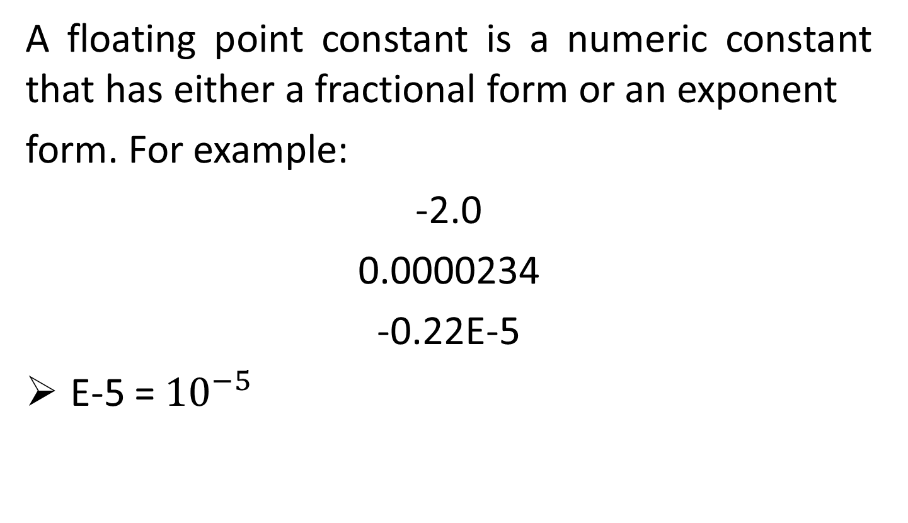
Floating point/Real constants
A floating point constant is a numeric constant that has either a fractional form or an exponent
form. For example:
-2.0
0.0000234
-0.22E-5
E-5 = ${10}^{−5}$

Slide 35
Floating point/Real constants
Real Constants : Real constant is base 10 number, which is represented in decimal 0r scientific/exponential notation.
Real Notation : The real notation is represented by an integer followed by a decimal point and the fractional(decimal) part. It is possible to omit digits before or after the decimal point.
Ex :
15.25
.75
30
-9.52
-92
+.94

Slide 36
Floating point/Real constants
Scientific/Exponential Notation: The general form of Scientific/Exponential notation is mantisha e exponent
The mantisha is either a real/floating point number expressed in decimal notation or an integer and the exponent is an integer number with an optional sign. The character e separating the mantisha and the exponent can be written in either lowercase or uppercase.
Ex : 1.5E-2
100e+3
-2.05e2

Slide 37
Floating point/Real constants
Rules for constructing real constants expressed in fractional form:
a) A real constant must have at least one digit.
b) It must have a decimal point.
c) It could be either positive or negative.
d) Default sign is positive.
e) No commas or blanks are allowed within a real constant.
Ex. +325.34, 426.0, -32.76, -48.5792

Slide 38
Floating point/Real constants
Rules for constructing real constants expressed in exponential form:
a) The mantissa part and the exponential part should be separated by a letter e.
b) The mantissa part may have a positive or negative sign.
c) Default sign of mantissa part is positive.
d) The exponent must have at least one digit, which must be a positive or negative integer.
Default sign is positive.
e) Range of real constants expressed in exponential form is -3.4e38 to 3.4e38.
Ex. +3.2e-5, 4.1e8, -0.2e+3, -3.2e-5

Slide 39


Character Constant
Single Character Constant : A character constant is either a single alphabet, a single digit, a single special symbol enclosed within single inverted commas.
a) it is value represent in ‘ ‘ (single quote).
b) The maximam length of a character constant can be 1 character.

Slide 40
Character Constant
String constant : A string constant is a sequence of characters enclosed in double quote, the characters may be letters, numbers, special characters and blank space etc.
EX :
“ict” , “a” , “+123” , “1-/a” "good" //string constant
““ //null string constant
“ “ //string constant of six white space
“x” //string constant having single character.
“Earth is round\n” //prints string with newline

Slide 41
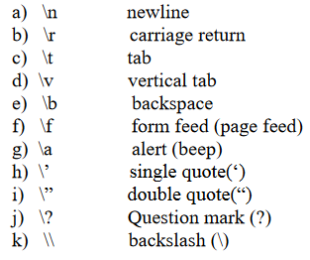
Character Constant
Escape characters or backslash characters:

Slide 42
Two ways to define constant in C
There are two ways to define constant in C programming.
1. const keyword
2. #define preprocessor

Slide 43
C const keyword
The const keyword is used to define constant in C programming.
const float PI=3.14;
Now, the value of PI variable can't be changed.
1. #include <stdio.h>
2. #include <conio.h>
3. void main(){
4. const float PI=3.14;
5. clrscr();
6. printf("The value of PI is: %f",PI);
7. getch();
8. }
Output:
The value of PI is: 3.140000

Slide 44
C #define preprocessor
The #define preprocessor is also used to define constant.
The #define preprocessor directive is used to define constant or micro substitution. It can use any basic data type.
Syntax:
#define token value
Let's see an example of #define to define a constant.
#include <stdio.h>
1. #define PI 3.14
2. main() {
3. printf("%f",PI);
4. }
Output:
3.140000

Slide 45
Thank you….

